Slide 1
Live Polling
Notes:
NEW to Alliance 2022 is Live Polling through the app. Starting January 31, presenters will have access to setup their own polls for each of their sessions. We will have instructions on the presenter portal page, but here are a few slides to get you started.

Slide 2
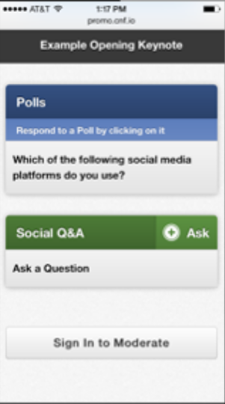
Live
Polling
Live polling is easier than ever!
All polls will be created and launched in the Super Forum Mobile App
Notes:
The presenter has control this year, from setting it up to launching and displaying in-session.

Slide 3
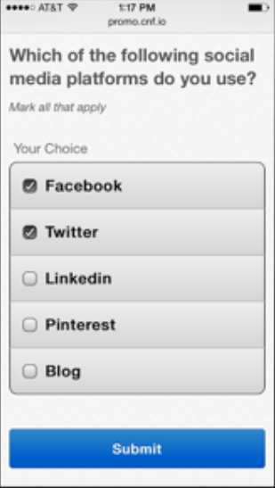
Live
Polling
Attendees will have access to respond to polls directly on their own devices
Notes:
Attendees will access polls in the session details. No extra work for them to download any other apps or technology to participate.

Slide 4
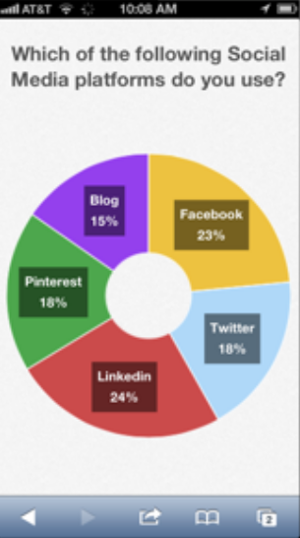
Live
Polling
You will view the results graphically, in real-time
Notes:
Finally, you will be able to instantly show your attendees the results. This tool will give you the opportunity to engage with your attendees more than we’ve ever been able to at Alliance.

Slide 5

Poll
Formats
Multiple Choice
Open Ended
Numerical Average
Brainstorming
Notes:
As you begin thinking of your questions that you may want to ask during your session, also think about what format might be the most fitting. Multiple Choice, Open Ended, Numerical Average…so let’s take a bit more of a visual look at the 3 options…

Slide 6
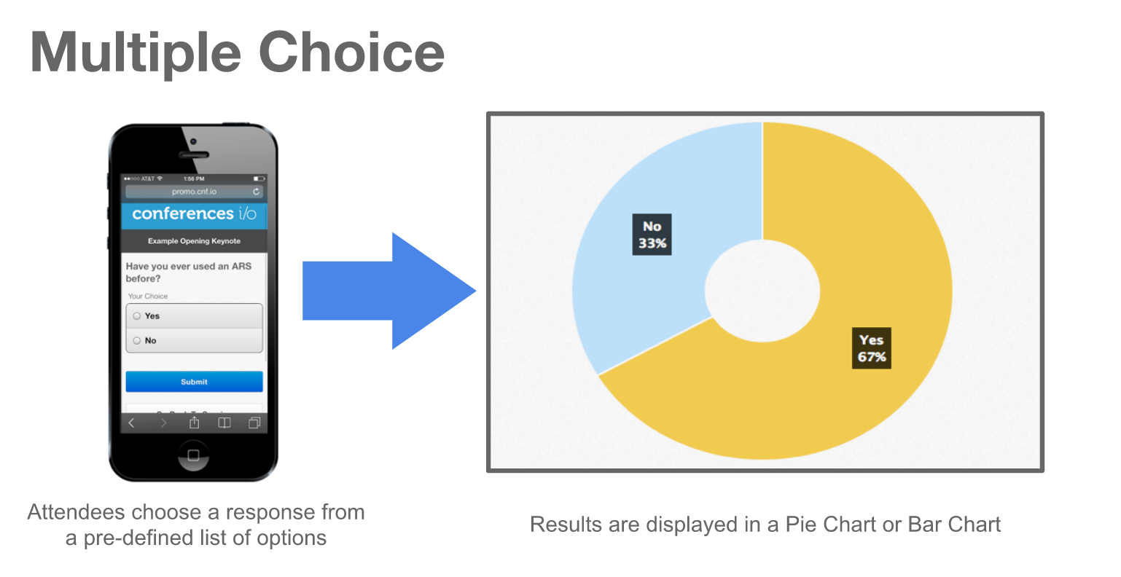
Notes:
Multiple Choice – If you choose to use the multiple choice, 3 or less response options fits well with a pie chart, however, 4 or more options works best with a bar chart.

Slide 7
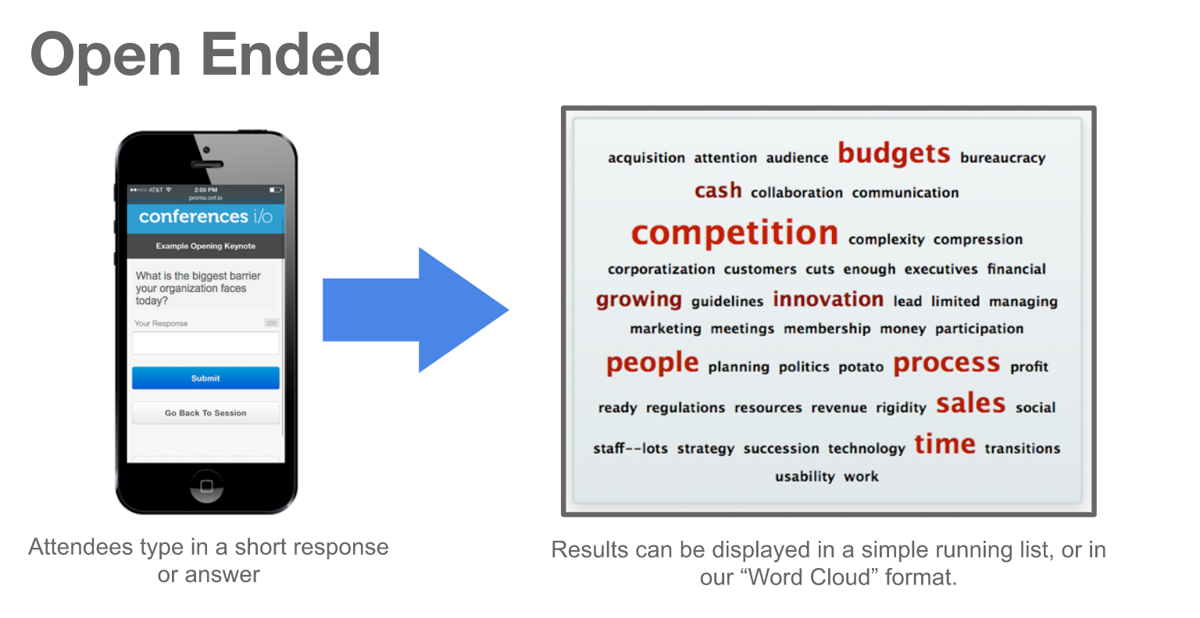
Notes:
Open ended can show a running list or word cloud. Word Clouds work best only when the attendees are responding with 1-2 words (not full sentences).

Slide 8
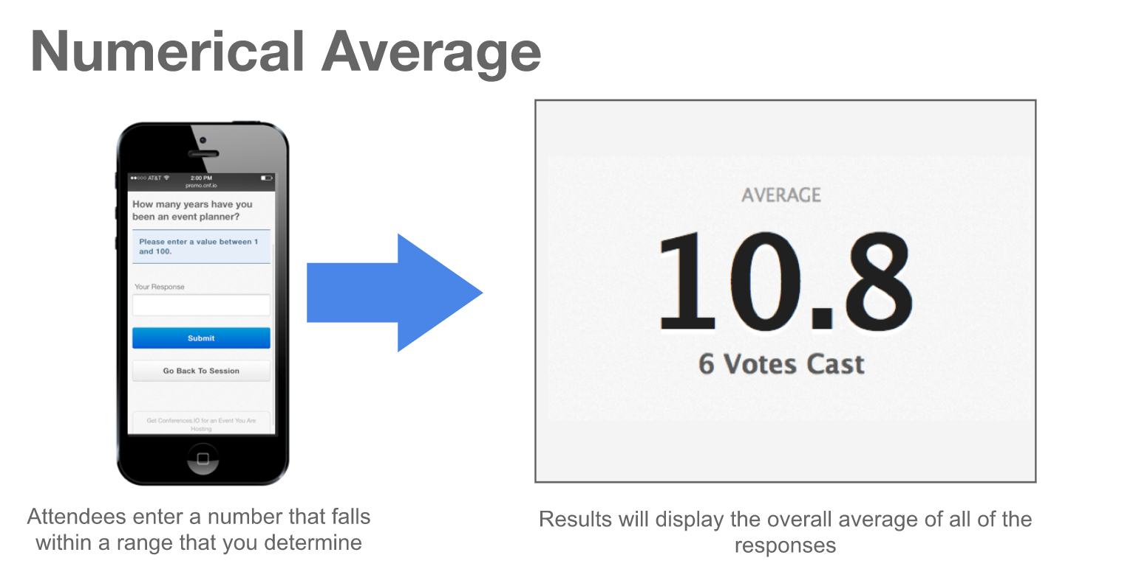
Notes:
Numerical Average shows an average of a range that you determine.

Slide 9

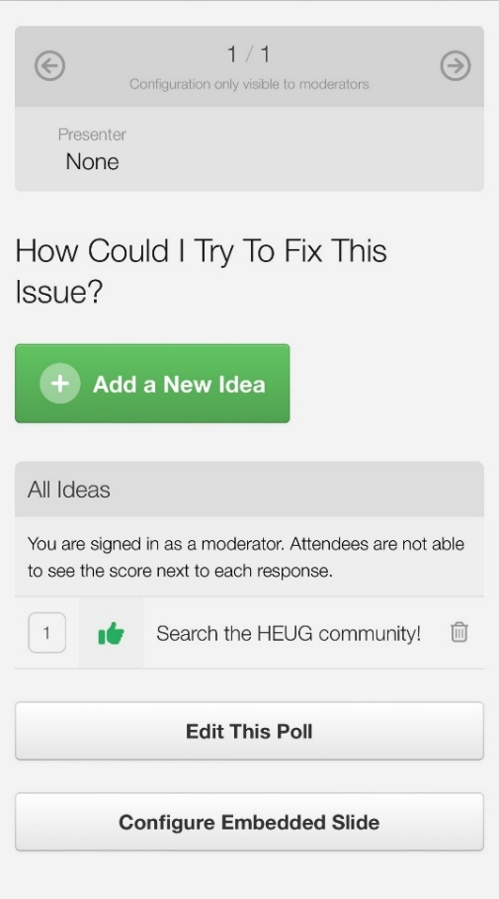
NEW OPTION: BRAINSTORMING!
  A great way to engage attendees.
Notes:
Numerical Average shows an average of a range that you determine.

Slide 10
Setting up a Poll
Notes:
NEW to Alliance 2022 is Live Polling through the app. Starting January 31, presenters will have access to setup their own polls for each of their sessions. We will have instructions on the presenter portal page, but here are a few slides to get you started.

Slide 11
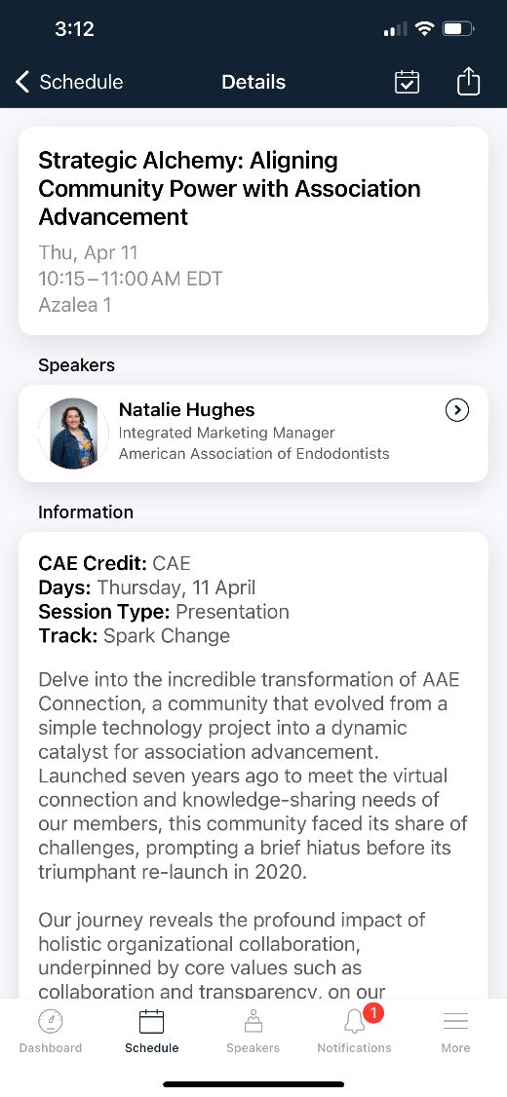
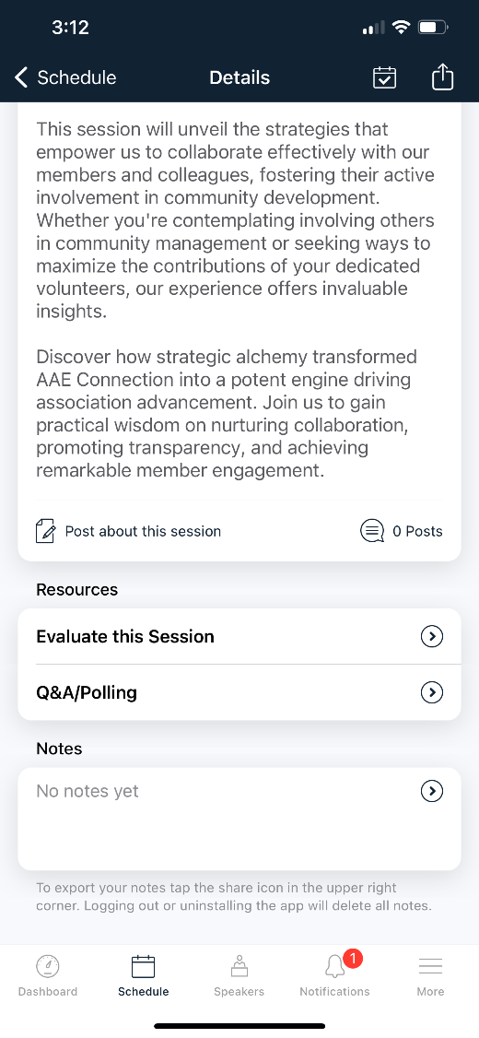
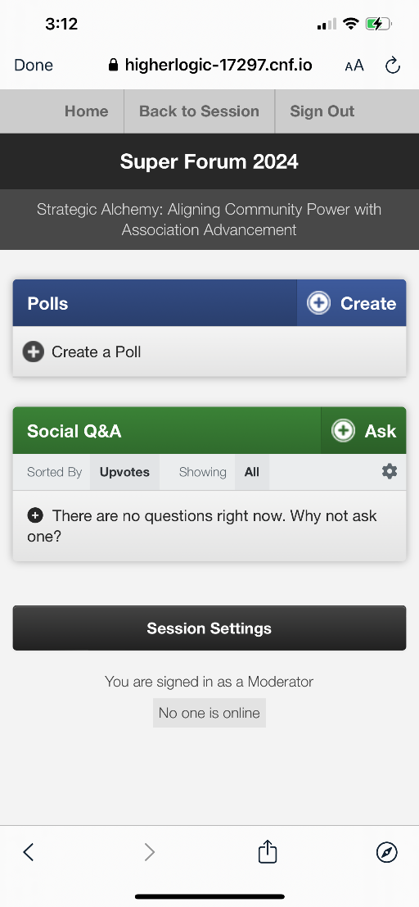
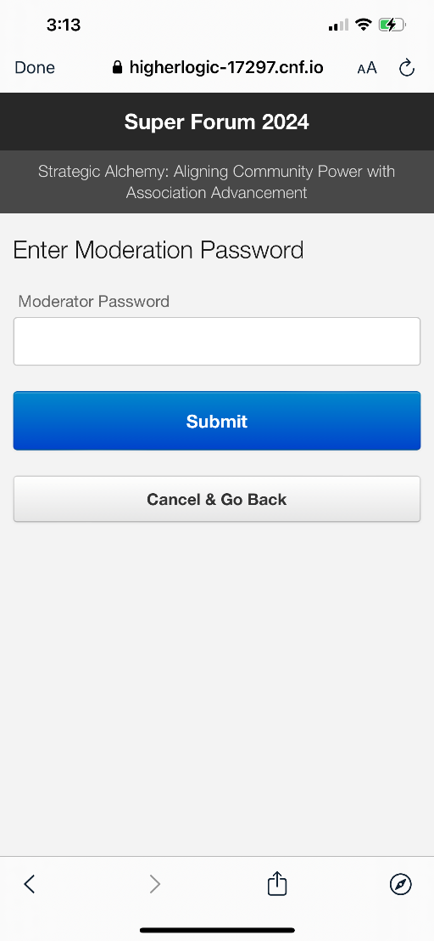
Select Your Session
Select Polling
Sign In
Enter Password: SF24Poll
Notes:
Numerical Average shows an average of a range that you determine.

Slide 12
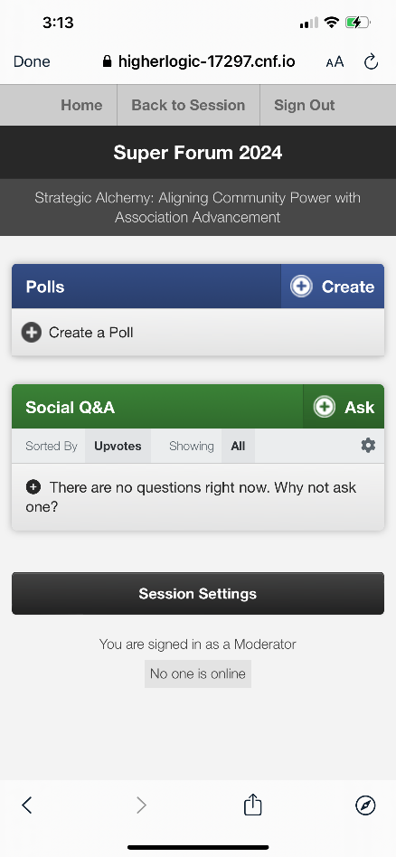
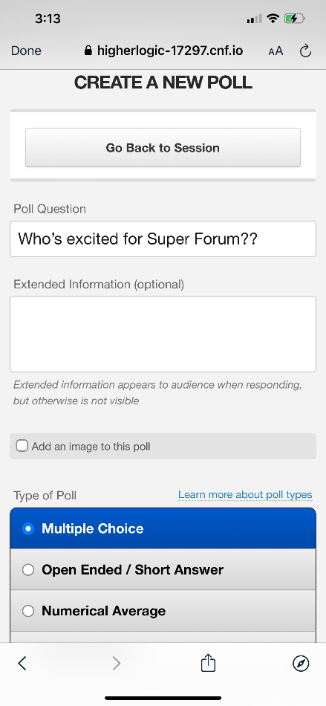
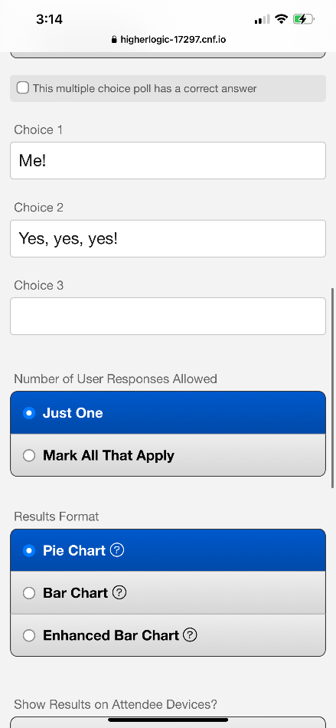
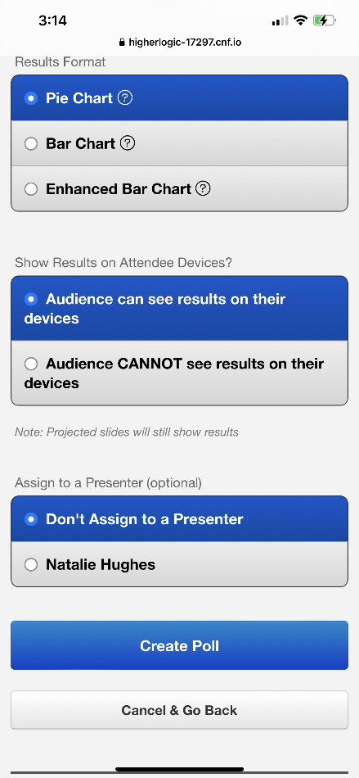

Enter Your Question &
Select a Type of Poll
Select Audience CAN see & Create Poll
Create a Poll
Select a Results Type
Notes:
Numerical Average shows an average of a range that you determine.

Slide 13
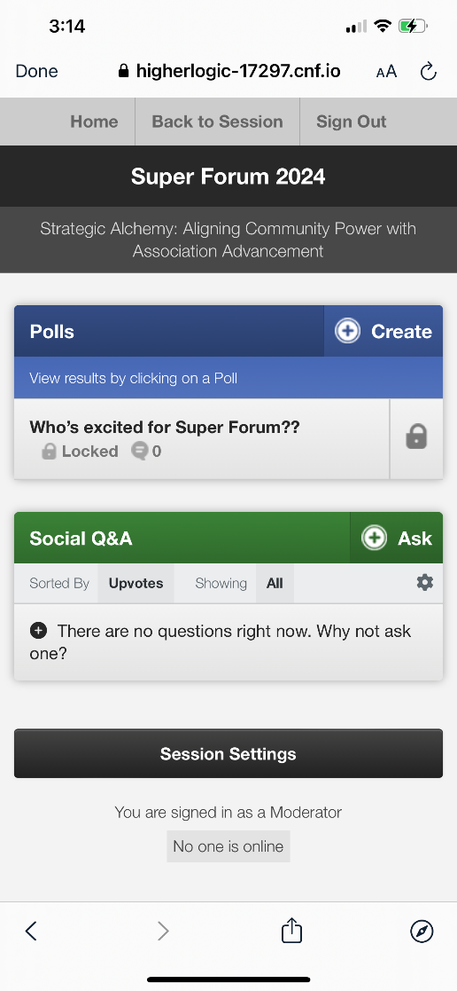
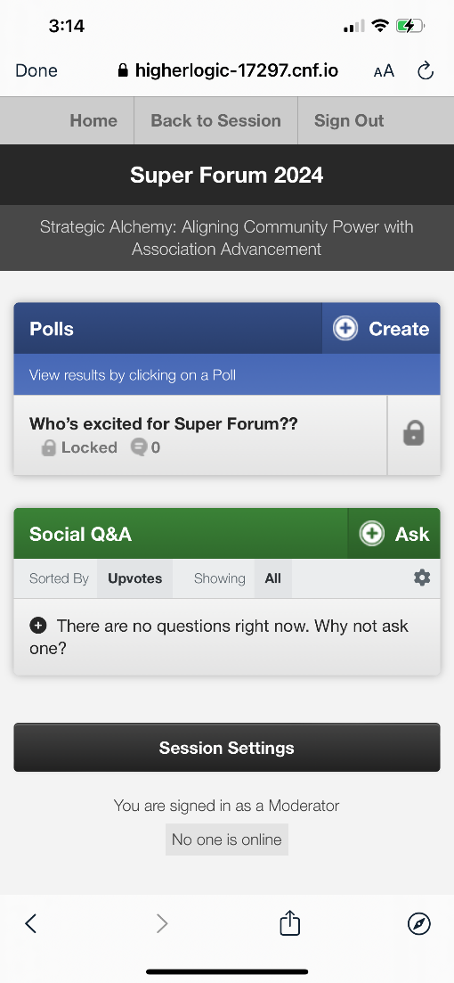
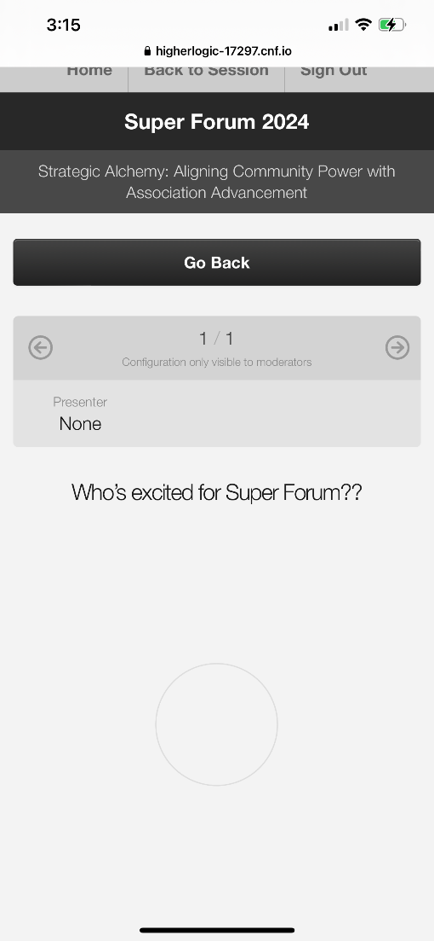
Your Poll is now Created & Locked (Not open to attendees)
Click the Lock Icon to Unlock to Launch Poll!
*Unlock one poll at a time to avoid confusion.
Once Polling is Complete, Go Back and Lock the Poll.
Notes:
Numerical Average shows an average of a range that you determine.

Slide 14
Live Polling Setup
Download and explore the Super Forum Event App. Find your session, add it to your agenda and get started on creating your polls. You can create your polls anytime between now and the conference.
SETUP
Create a slide in your deck to know when it's time to launch the poll. You can include the question, or simply use "Poll Time!" This will cue attendees to navigate to the app to participate.
CREATE SLIDE CUE
You will launch and run your polls live during your session—directly from the app! Be sure to practice and prepare.
LAUNCH
Notes:
Live Polling Setup – again we will Launch the setup instructions on January 31st and allow you to begin setup. There is no cutoff date since the presenters will be managing their own sessions, however I highly suggest taking the time to set this up early and take the time to practice with this feature, prior to being on-site at Alliance.

Slide 15
Participating in a Poll
Notes:
NEW to Alliance 2022 is Live Polling through the app. Starting January 31, presenters will have access to setup their own polls for each of their sessions. We will have instructions on the presenter portal page, but here are a few slides to get you started.

Slide 16
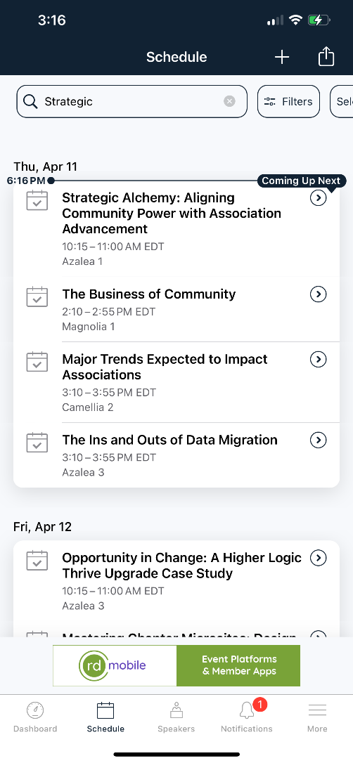

Search for the Session or Find it on Your Agenda
Go to the Session
Select Polling
Notes:
Numerical Average shows an average of a range that you determine.

Slide 17

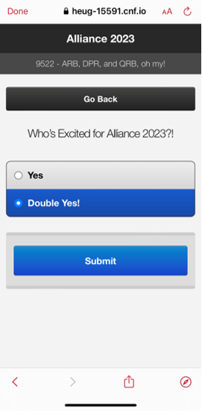
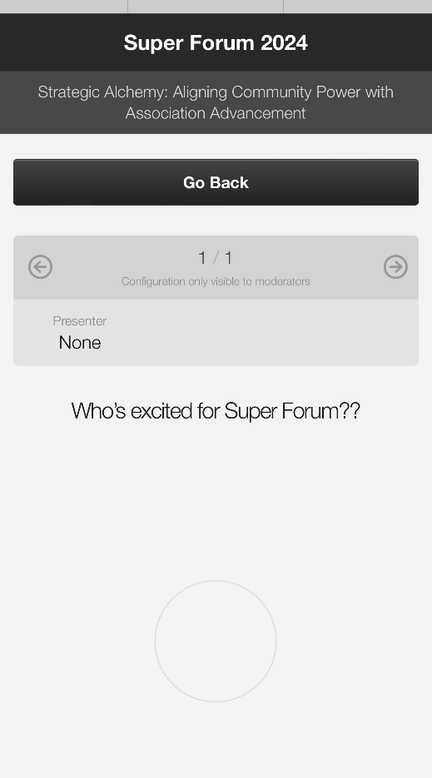

Click the Poll Question
Select Your Answer and Submit
View the Results!
Notes:
Numerical Average shows an average of a range that you determine.

